Slide 1

Bright car analysis

Slide 2
Insights
Black, white, sliver and gray are dominating dales.
These colors usually have a broader buyer and are frequently resold.
Recommendations
Avoid overstocking less popular colours such as turquoise, lime and pink as they have few transactions and they take longer to sell.

Slide 3
insights
December and January show stronger revenue as they both contribute 54% of revenue.
Peaks may be influenced by seasonal buying behavior, for example, cars may be perceived as cheaper during January and most people want to travel in December.
Low revenue months indicate a change in customer preference.
Recommendations
Have promotions with the months that show strong performance to increase sales.
For the low revenue months, increase marketing campaigns.

Slide 4
Insights
Positive values indicate profit above market value
Negative values indicate a loss.
As shown on the graph , Bright car makes a loss, the reasons of the loss could be being overpriced by the suppliers.
The cars may be perceived to be in a poor condition by the market
There may be weak demand for the vehicles.
Recommendations
Re-evaluate the buying strategy for models that frequently shows losses.
For negotiating purchase prices, use the MMR as the benchmark
Strengthen sourcing cars on profitable segments.

Slide 5
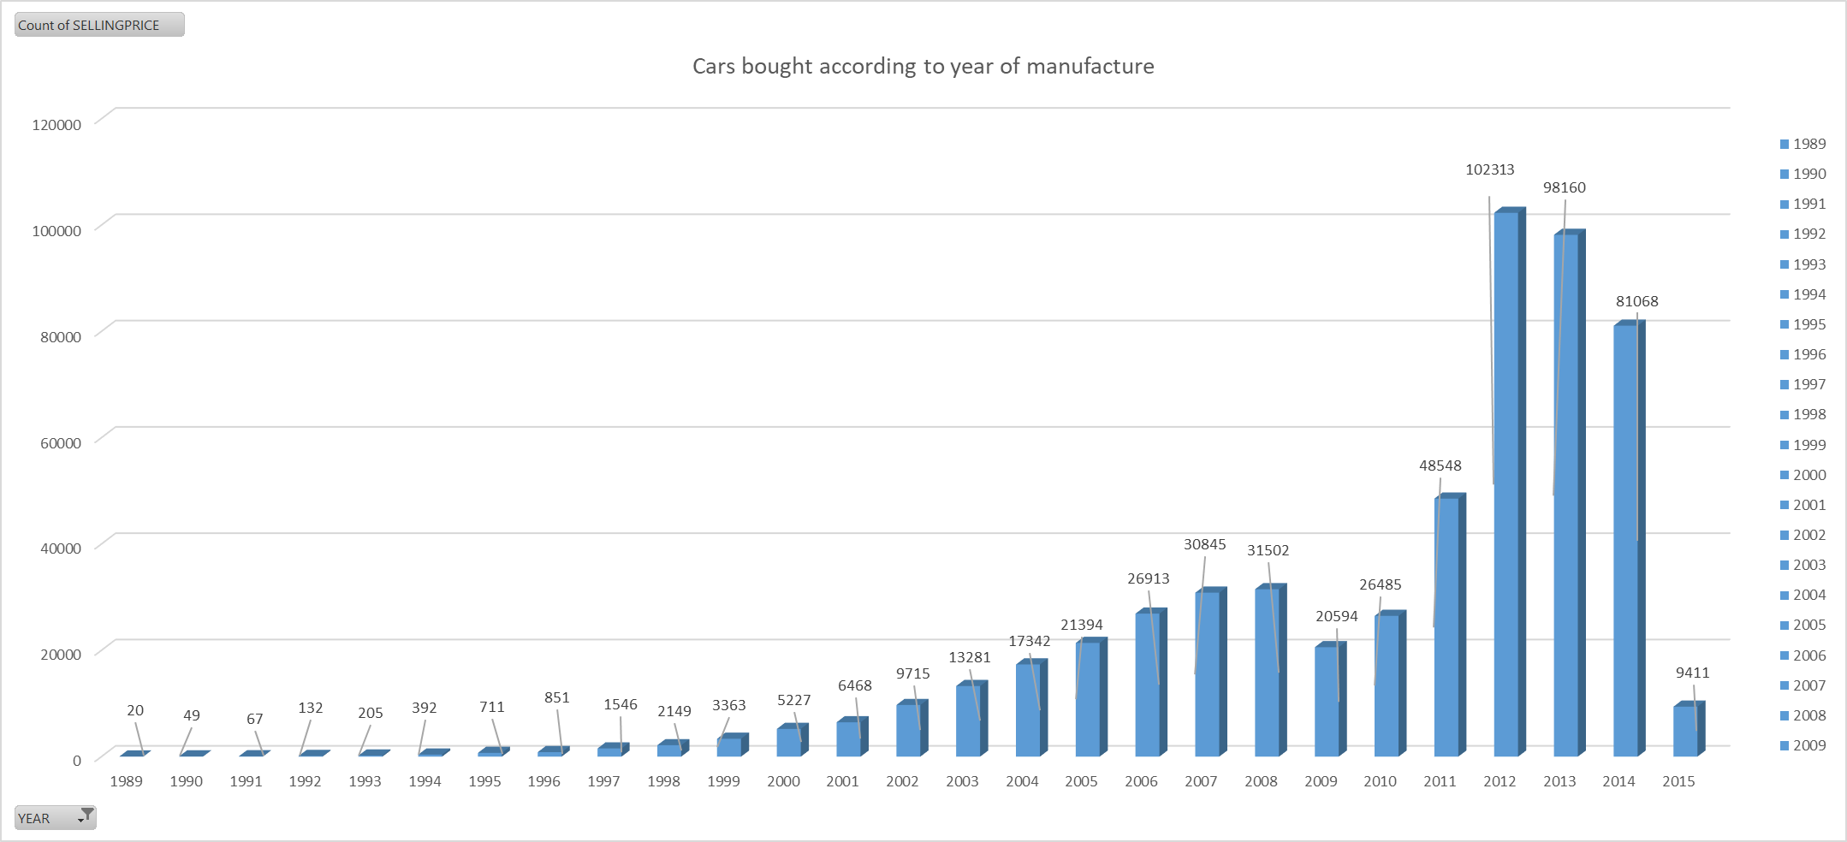
Insights
According to the graph, the years with the most sales is 2012,2013 and 2014.
The customers prefer the latest models compared to the oldest model as shown in the graph,1989 to 1994’s transactions range from 20-400.
Recommendations
Refurbish the cars from 1989 to 1994 to appeal to the customers.
Run promotions on the cars that are frequently sold

Slide 6
Insights
The average selling price shows the difference from one state to another.
The states that achieve higher selling prices may reflect high demand, high vehicle quality.
Lower average selling prices may reflect market saturation, there may be higher supply than demand.
The states may have price sensitive buyers.
Recommendations
Offer promotions that have low performing sates in order to increase demand.
Distribute mid and lower value vehicles to sates with price sensitive markets

Slide 7
THE END

